Slide 1
SGEMM GPU Kernel Performance Analysis
An In-Depth Exploration with Python and R
Submitting by: Sk. Nazma
221FA14005
Submitted to: Dr . k Abraham peele sir

Slide 2
Presentation Outline:
development of the code
Step-by-Step Breakdown of the Approach
data summary
Industry Overview: GPU Kernel Performance
Business Problem Statement
Dataset Description and Plan of Action
Exploratory Data Analysis (EDA)
Histogram of data
Correlation matrix
Boxplot,linear regression plot,scatter plot’s
Data Processing
Data splitting
Conclusion

Slide 3
Development of the Code
Python and R Scripts:
Write Python and R code for:
Data Loading and Exploration: Importing and exploring the dataset.
EDA: Creating visualizations and charts.
Preprocessing: Cleaning and preparing the data.
Modeling: Implementing and evaluating models.
Hyperparameter Tuning: Adjusting and optimizing model parameters.
Metrics Evaluation: Calculating and interpreting performance metrics.

Slide 4
Data Summary:
SGEMM (Single-Precision General Matrix Multiply) is a fundamental matrix operation where two matrices are multiplied and added to a third matrix. It is widely used in fields like machine learning and scientific computing.
SGEMM GPU Kernel Performance refers to how efficiently this operation is executed on a GPU (Graphics Processing Unit). Key aspects include:
There are 14 parameter, the first 10 are ordinal and can only take up to 4 different powers of two values, and the 4 last variables are binary. Out of 1327104 total parameter combinations, only 241600 are feasible (due to various kernel constraints). This data set contains the results for all these feasible combinations.
Columns name:
'MWG', 'NWG', 'KWG', 'MDIMC', 'NDIMC', 'MDIMA', 'NDIMB', 'KWI', 'VWM', 'VWN', 'STRM', 'STRN', 'SA', 'SB', 'Run1 (ms)', 'Run2 (ms)', 'Run3 (ms)', 'Run4 (ms)'

Slide 5
Step-by-Step Breakdown of the Approach:
Understanding the Problem: GPU kernel performance optimization.
Exploratory Data Analysis: Investigating relationships and trends in the data.
Feature Engineering: Creating new features (target) from raw data.
Model Training: Implementing multiple models (linear regressions,Decision Trees, Random Forest, etc.).
Hyperparameter Tuning: Enhancing model performance.
Evaluation: Using metrics like MSE, MAE, and R2 to assess each model.
Insights and Business Application: Translating technical findings into real-world business improvements.

Slide 6
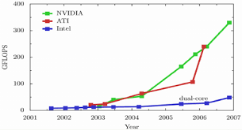
Industry Overview: GPU Kernel Performance
The matrix multiplication task (SGEMM) is vital for high-performance computing, particularly in areas such as machine learning, scientific simulations, and graphics rendering. These industries rely on efficient GPU performance to handle large-scale computations. Optimizing GPU kernel performance, like minimizing matrix operation runtimes, is crucial for improving processing speed, lowering costs, and ensuring energy-efficient operations in computationally heavy fields.

Slide 7
Business Problem Statement:
The key business problem is optimizing the runtime of SGEMM operations (matrix multiplication on GPUs). Faster execution times directly impact operational efficiency for businesses relying on large-scale data processing, reducing the costs associated with longer runtimes and hardware usage. This improvement can be applied across industries like AI, gaming, and scientific research where rapid computation is essential.

Slide 8
Dataset Description and Plan of Action:
Dataset: The SGEMM dataset contains features representing GPU configurations (e.g., MWG, KWG, MDIMA) and the runtime performance across four runs (Run1, Run2, Run3, Run4).
Plan of Action:
Perform exploratory data analysis (EDA) to understand the data and spot trends or correlations.
Conduct feature engineering, including the creation of a target variable by averaging the four runtime columns.
Preprocess the data (scaling, splitting) for machine learning models.
Apply different machine learning models and fine-tune hyperparameters.
Evaluate the models using multiple metrics (MAE, MSE, RMSE, R2).

Slide 9
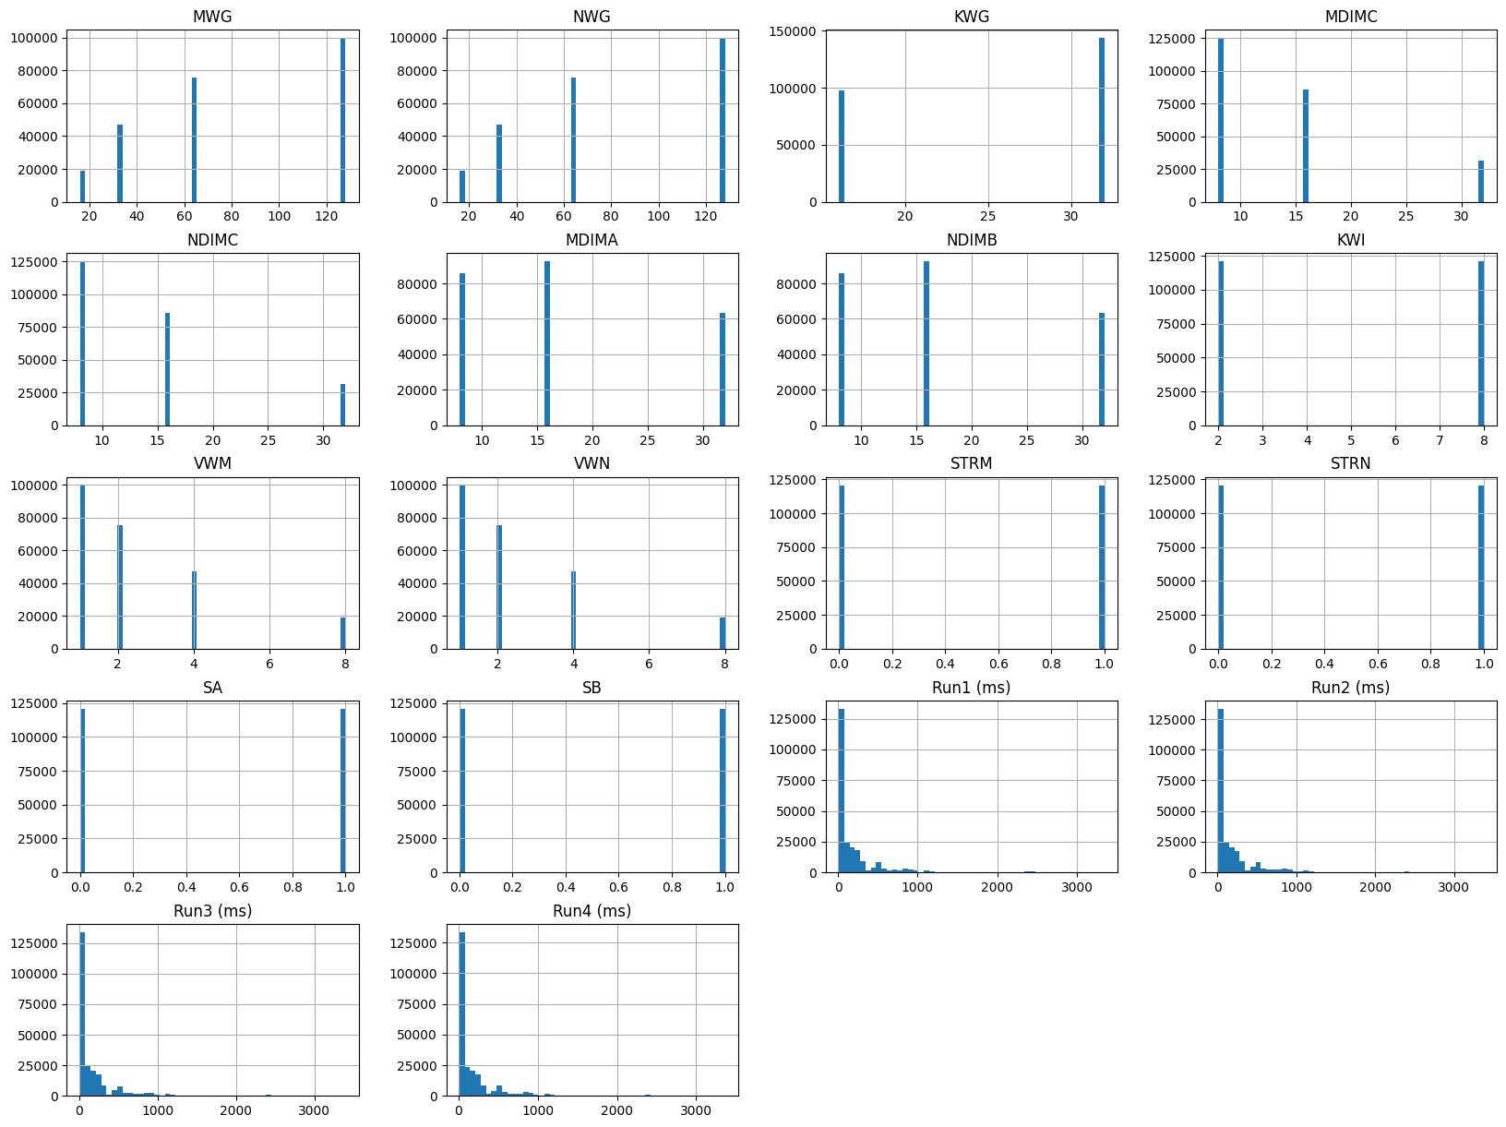
SGEMM dataset and the runtime performance:

Slide 10
Exploratory Data Analysis (EDA):
Here are the five charts you can include:
Histogram: Distribution of run times across the four different runs (Run1, Run2, Run3, Run4).
Correlation Matrix: Show how features like MWG, KWG, MDIMA, etc., correlate with the target.
Boxplot: Compare the variance in runtime across different runs.
Scatter Plot: Plot MWG against the target to show how changes in MWG impact the execution time.
Actual vs. Predicted Plot: Display the predicted versus actual runtime using the best-performing model.

Slide 11
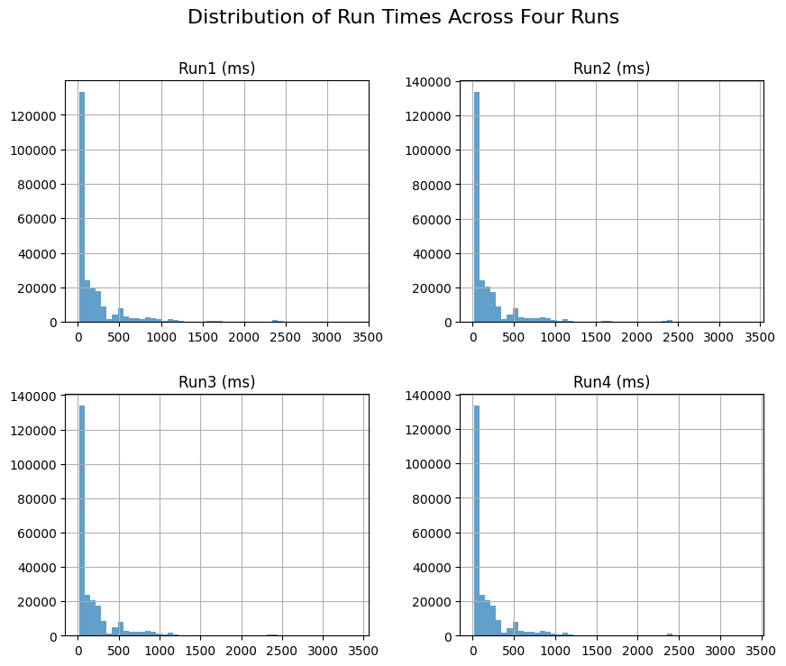
Histogram: (Run1, Run2, Run3, Run4).

Slide 12
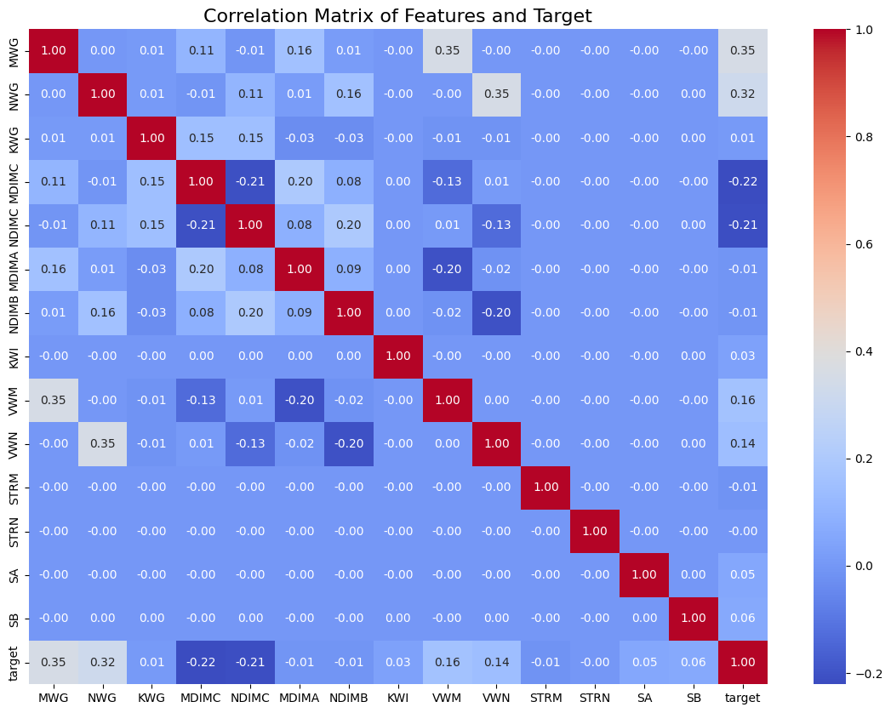
Correlation matrix:
when the correlation is said to be close to zero it generally means that the relation between two variables is week.it is suggested that changes in one variable are not well-predicted by changes in the other variable based on linear pattern.

Slide 13
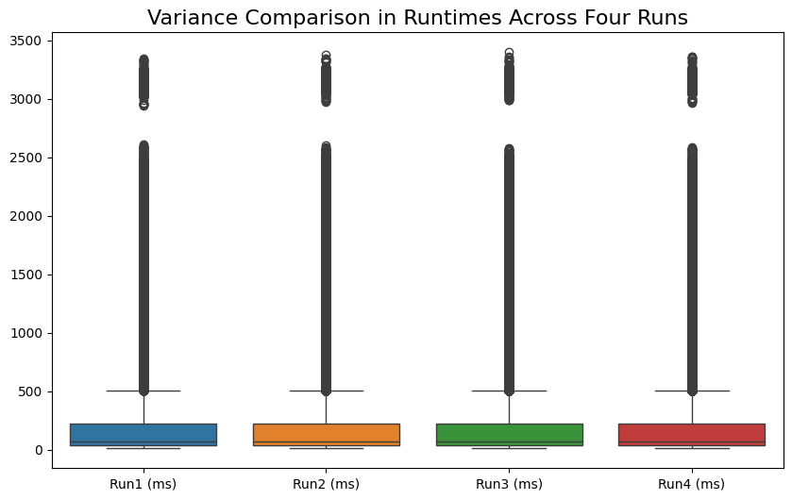
Boxplot for the variance comparison across different runs:

Slide 14
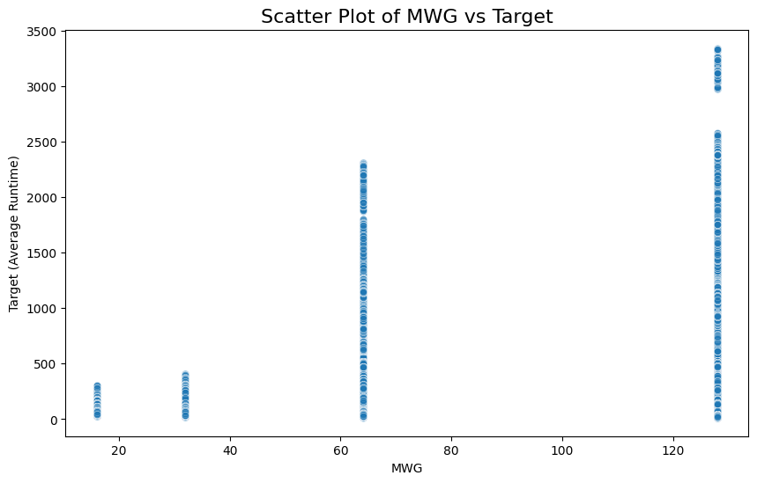
Scatter Plot: Plot MWG against the target to show how changes in MWG impact the execution time.

Slide 15

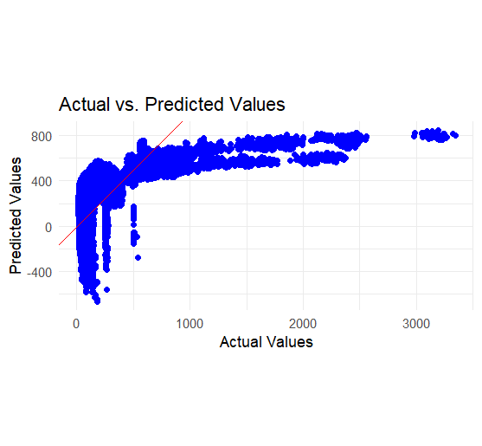
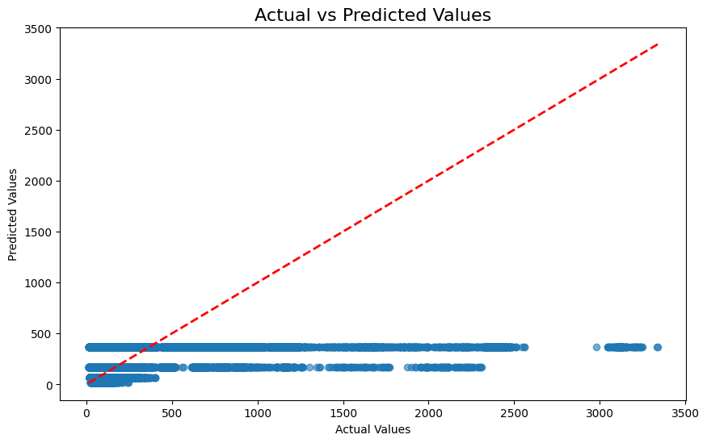
Actual vs. Predicted Plot: To Display the predicted versus actual runtime using the best-performing model.(linear regression plot)

Slide 16
Data Preprocessing Methods:
Q) Explain data wrangling and feature engineering techniques used.
Feature Engineering: You created a new column "target" by averaging the four runtime columns (Run1, Run2, Run3, Run4). This consolidated the data for a more unified target variable to predict.
Data Wrangling:
Removed unnecessary columns (Run1, Run2, Run3, Run4 after creating the target).
Checked for duplicates, missing values, and anomalies in the dataset.
Scaled the features using
StandardScaler to normalize the range for machine learning models.

Slide 17
Data Splitting and Models Used:
Q)Discuss reasons for data splitting.
Splitting: Data was split into training (80%) and testing sets (20%) to evaluate the model’s performance on unseen data.
Models Used:
R: Linear regression was used to model the relationship between MWG and target runtime.
Python: Advanced machine learning models, including Decision Trees, Extra Trees, Random Forest, LightGBM, and CatBoost, were applied to predict target runtime.

Slide 18
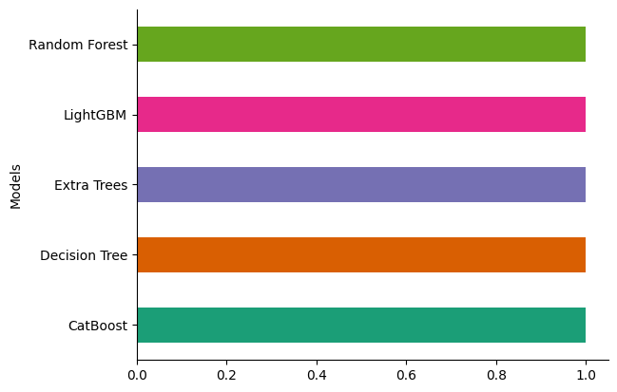
Hyperparameter Tuning Improvements:
Q)Explain the tuning process and improvements achieved.
Improvements: Hyperparameter tuning was applied to the Random Forest, LightGBM, and CatBoost models, yielding better results. Example: CatBoost with optimal hyperparameters gave better R-squared values and reduced errors (RMSE).
Show a performance comparison (before and after tuning) for the best models using evaluation metrics like R2, MSE, and MAE.

Slide 19
Insights and Evaluation Metrics:
Q) Summarize key insights.
Discuss evaluation metrics and their relevance
Best Performing Model: After evaluating multiple models, CatBoost (after hyperparameter tuning) provided the best performance with a high R-squared value and low RMSE.
Key Insights:
The correlation matrix revealed that some features (e.g., MWG, KWG) had stronger relationships with the target.
The Random Forest and CatBoost models showed significant improvement in accuracy after tuning.

Slide 20
Model Explainability and Business Impact:
Model Explainability: Techniques like SHAP values or feature importance in Random Forest and CatBoost models can explain which features contributed the most to the predictions.
Business Impact: Faster GPU performance leads to reduced hardware costs, increased efficiency in processing large datasets, and enhanced overall productivity in industries like AI and scientific computing.

Slide 21

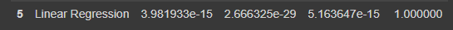
MAE,MSE,RMSE,R2 value results:
R result:
Python results:
We know, the lesser the value of MSE, RMSE, the better is the algorithm and the higher the value of R-sq and Adjusted R-sq, the better is the algorithm.
From the above comparison table, we can see, Decision Tree model has the least MSE, RMSE scores and the highest R-sq and Adjusted R-sq scores.
Therefore we can conclude that Decision Tree model is yielding best results for this particular project.
Since the Decision Tree model has the least MSE, RMSE scores and the highest R-sq and Adjusted R-sq scores

Slide 22


